Slide 1
BASIC OF Statistics
BY
Muhamad Ameer Abbas

Slide 2
Basics of Statistics
Definition: Science of collection, presentation, analysis, and reasonable interpretation of data.
Statistics presents a rigorous scientific method for gaining insight into data. For example, suppose we measure the weight of 100 patients in a study. With so many measurements, simply looking at the data fails to provide an informative account. However statistics can give an instant overall picture of data based on graphical presentation or numerical summarization irrespective to the number of data points. Besides data summarization, another important task of statistics is to make inference and predict relations of variables.

Slide 3
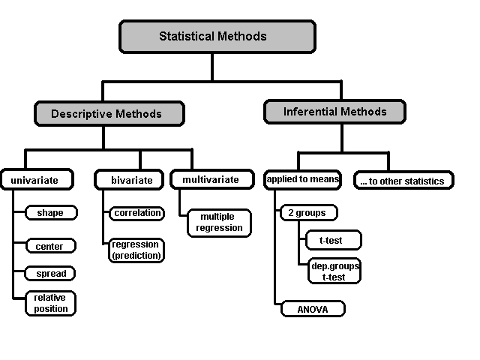
A Taxonomy of Statistics

Slide 4
Statistical Description of Data
Statistics describes a numeric set of data by its
Center
Variability
Shape
Statistics describes a categorical set of data by
Frequency, percentage or proportion of each category

Slide 5
Some Definitions
Variable - any characteristic of an individual or entity. A variable can take different values for different individuals. Variables can be categorical or quantitative. Per S. S. Stevens…
Nominal - Categorical variables with no inherent order or ranking sequence such as names or classes (e.g., gender). Value may be a numerical, but without numerical value (e.g., I, II, III). The only operation that can be applied to Nominal variables is enumeration.
Ordinal - Variables with an inherent rank or order, e.g. mild, moderate, severe. Can be compared for equality, or greater or less, but not how much greater or less.
Interval - Values of the variable are ordered as in Ordinal, and additionally, differences between values are meaningful, however, the scale is not absolutely anchored. Calendar dates and temperatures on the Fahrenheit scale are examples. Addition and subtraction, but not multiplication and division are meaningful operations.
Ratio - Variables with all properties of Interval plus an absolute, non-arbitrary zero point, e.g. age, weight, temperature (Kelvin). Addition, subtraction, multiplication, and division are all meaningful operations.

Slide 6
Some Definitions
Distribution - (of a variable) tells us what values the variable takes and how often it takes these values.
Unimodal - having a single peak
Bimodal - having two distinct peaks
Symmetric - left and right half are mirror images.

Slide 7
Frequency Distribution
Consider a data set of 26 children of ages 1-6 years. Then the frequency distribution of variable ‘age’ can be tabulated as follows:
Frequency Distribution of Age
Age | 1 | 2 | 3 | 4 | 5 | 6
Frequency | 5 | 3 | 7 | 5 | 4 | 2
Grouped Frequency Distribution of Age:
Age Group | 1-2 | 3-4 | 5-6
Frequency | 8 | 12 | 6

Slide 8
Cumulative Frequency
Cumulative frequency of data in previous page
Age | 1 | 2 | 3 | 4 | 5 | 6
Frequency | 5 | 3 | 7 | 5 | 4 | 2
Cumulative Frequency | 5 | 8 | 15 | 20 | 24 | 26
Age Group | 1-2 | 3-4 | 5-6
Frequency | 8 | 12 | 6
Cumulative Frequency | 8 | 20 | 26

Slide 9
Data Presentation –Categorical Variable
Bar Diagram: Lists the categories and presents the percent or count of individuals who fall in each category
Treatment Group | Frequency | Proportion | Percent (%)
1 | 15 | (15/60)=0.25 | 25.0
2 | 25 | (25/60)=0.333 | 41.7
3 | 20 | (20/60)=0.417 | 33.3
Total | 60 | 1.00 | 100

Slide 10
Data Presentation –Categorical Variable
Pie Chart: Lists the categories and presents the percent or count of individuals who fall in each category.
Treatment Group | Frequency | Proportion | Percent (%)
1 | 15 | (15/60)=0.25 | 25.0
2 | 25 | (25/60)=0.333 | 41.7
3 | 20 | (20/60)=0.417 | 33.3
Total | 60 | 1.00 | 100

Slide 11
Numerical Presentation
A fundamental concept in summary statistics is that of a central value for a set of observations and the extent to which the central value characterizes the whole set of data. Measures of central value such as the mean or median must be coupled with measures of data dispersion (e.g., average distance from the mean) to indicate how well the central value characterizes the data as a whole.
To understand how well a central value characterizes a set of observations, let us consider the following two sets of data:
A: 30, 50, 70
B: 40, 50, 60
The mean of both two data sets is 50. But, the distance of the observations from the mean in data set A is larger than in the data set B. Thus, the mean of data set B is a better representation of the data set than is the case for set A.

Slide 12
Methods of Center Measurement
Center measurement is a summary measure of the overall level of a dataset
Commonly used methods are mean, median, mode, geometric mean etc.
Mean: Summing up all the observation and dividing by number of observations. Mean of 20, 30, 40 is (20+30+40)/3 = 30.

Slide 13
Shape of Data
Shape of data is measured by
Skewness
Kurtosis

Slide 14
Skewness
Measures asymmetry of data
Positive or right skewed: Longer right tail
Negative or left skewed: Longer left tail

Slide 15
Kurtosis
Measures peakedness of the distribution of data. The kurtosis of normal distribution is 0.

Slide 16
Thank you

